Slide 1


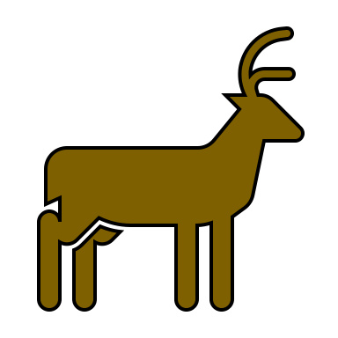









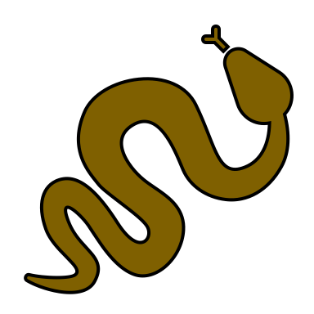

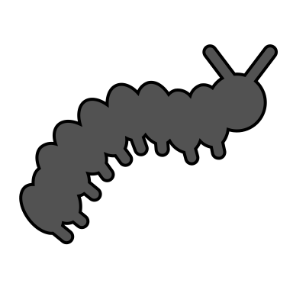

Slide 3
BIODIVERSITY
Disease
Pollination
Photosynthesis

Slide 4
Group members
Plot
Number of plant species
Number of pollinators
Leaves with damage
Height 1
Height 2
Height 3
Hypothesis

Slide 6
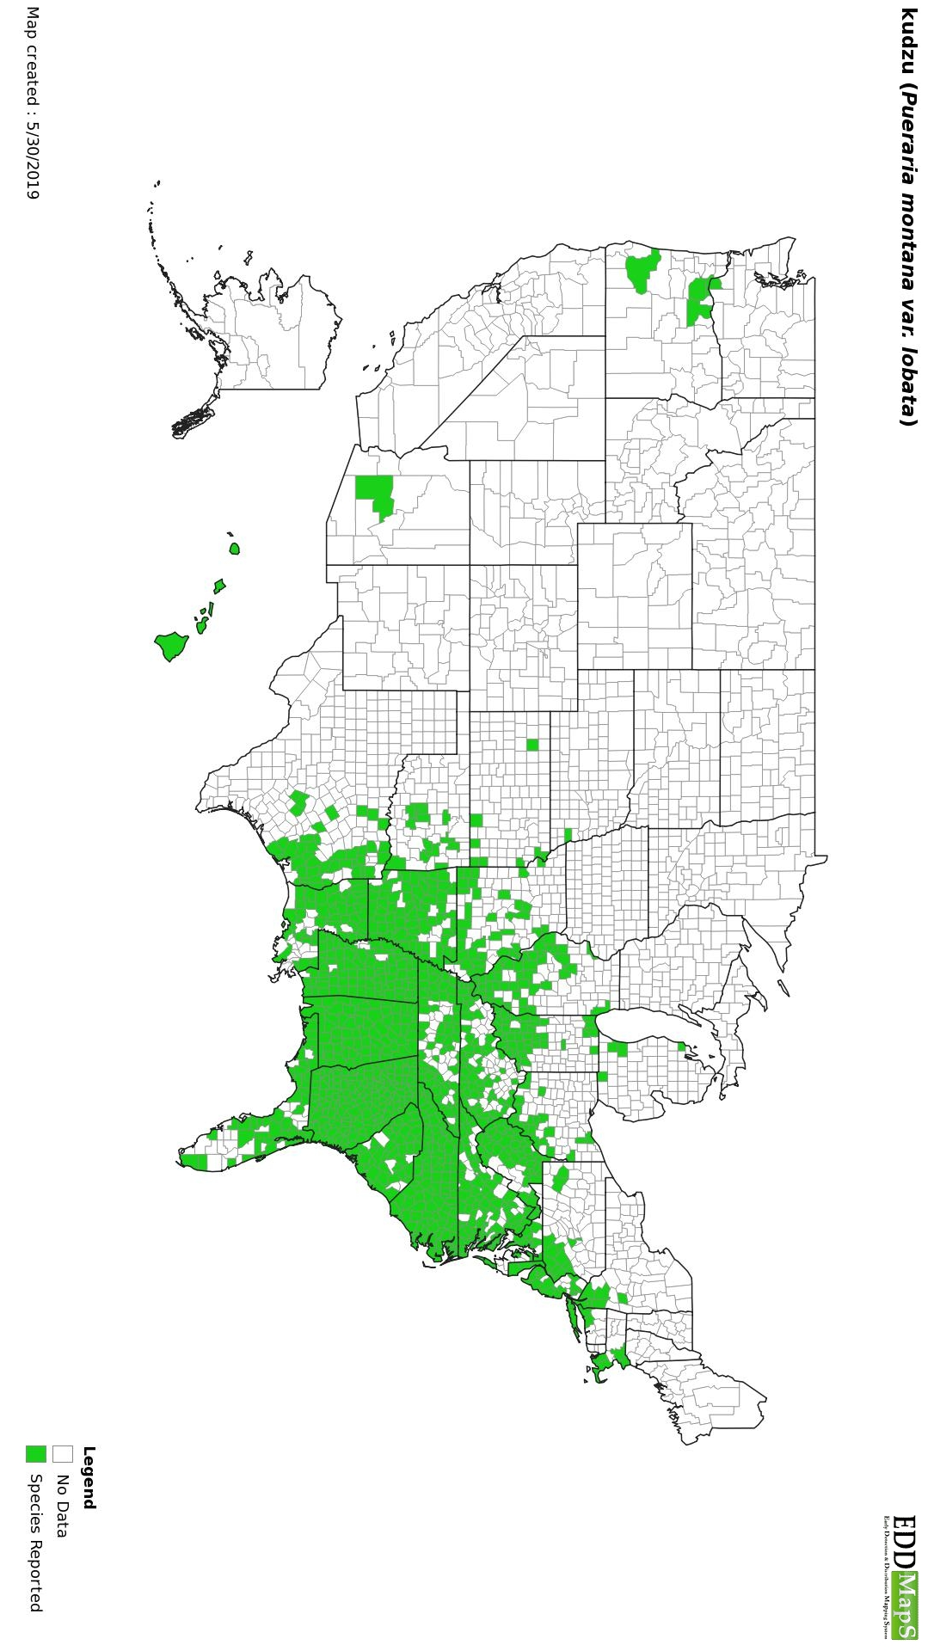

Slide 8
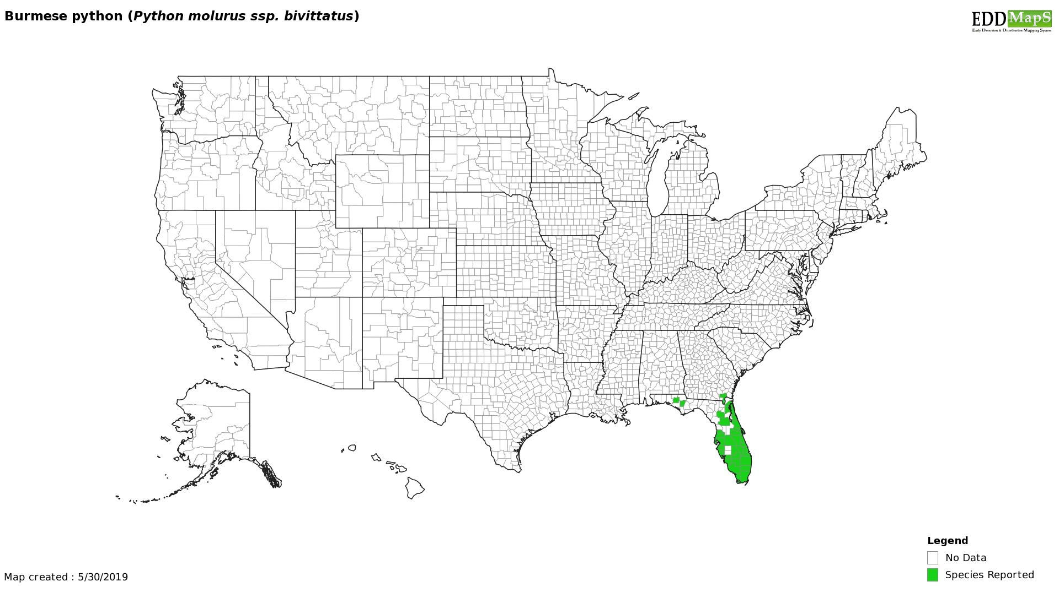

Slide 10
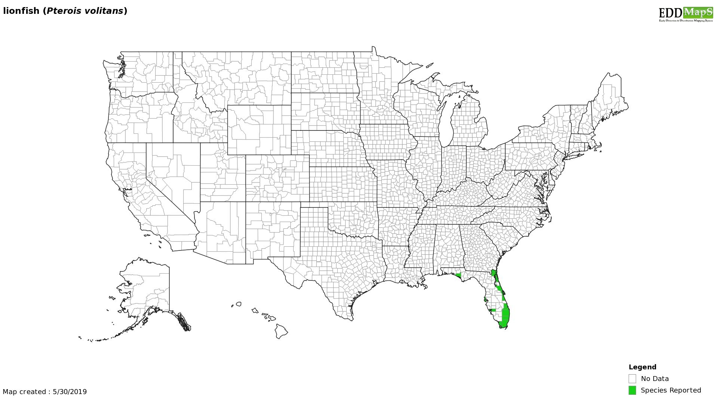

Slide 11
Group members
Pot
Species
Fungicide
Height
Leaf weight
Leaf area
Hypothesis

